Slide 1
UAVs and Drones
Overview and Analysis

Slide 2
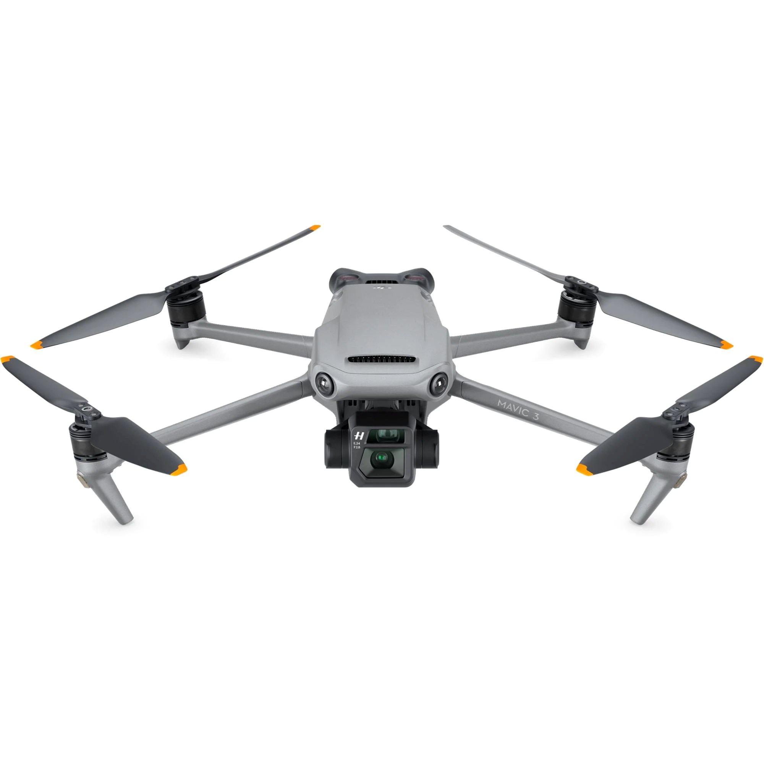
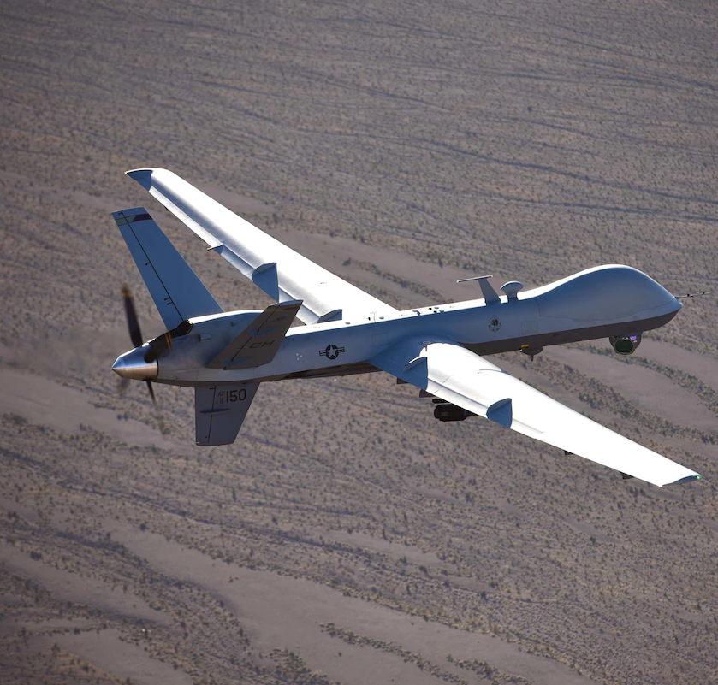
Unmanned Aerial Vehicle (UAV)
Unmanned Aerial Vehicles, or drones, come in many shapes, sizes and applications:
Can be controlled through a wireless connection or predetermined programming.
Can be fitted with different types of equipment for different tasks. Examples include
Cameras
Weapons Systems
Manipulators/Tools
Sensors and Survey Instruments
Speakers
DJI – Mavic Pro
MQ-9 Reaper – US Air Force

Slide 3
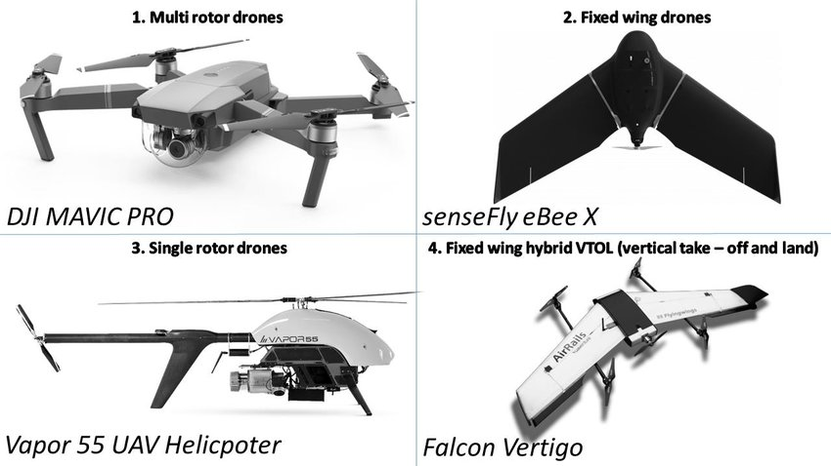
Assembly
There are 4 main types of UAV

Slide 4
Operating Principle
Thales Drone?

Slide 5
Applications
Survey
Defence
Delivery
Agricultural
Check Drones.gov

Slide 6
What makes it a Mechatronic System?
Refer to study on PLCs

Slide 7
Market Survey and Groups of Interest
Wait for sample to get back surely

Slide 8
Challenges Moving Forward
Cost
Batteries
Ethics
Investigate

Slide 9
Future Developments
Artificial Intelligence
UAV ‘Copilot’s
Solar?
Battery tech?

Slide 10
References

Slide 11
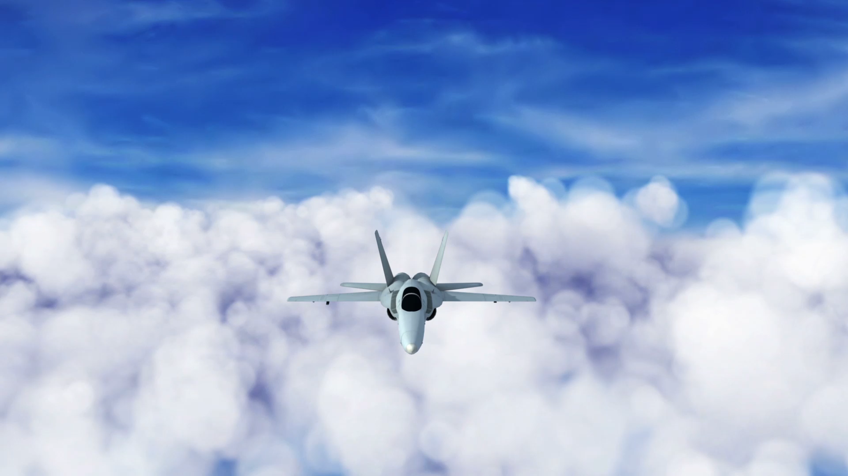
Q/A

